Slide 1
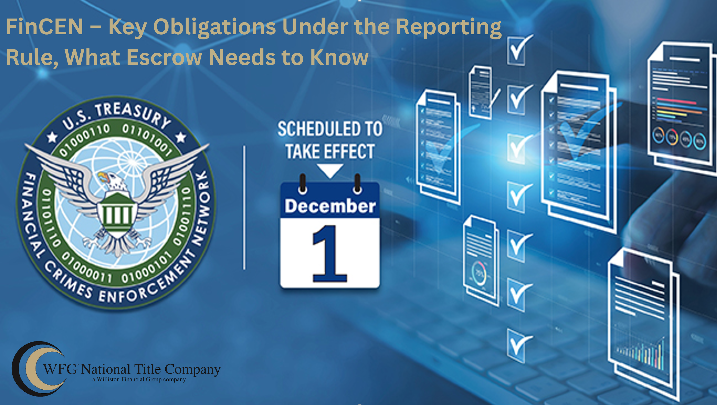
Theresa Williamson, CLC, CPTM - SVP Compliance, National Training Manager| twilliamson@willistonfinancial.com

Slide 2

Purpose of the Rule
Similar to the CTA, but separate and specific to residential real estate transfers of ownership
Increase transparency in residential real estate transactions
Prevent money laundering, terrorist financing, and illicit finance when ownership is transferred to legal entities.
wfgtitle.com

Slide 3
Who must comply
Title insurance agents, attorneys, settlement agents, and escrow officers involved in residential real estate closings
Reporting person is responsible for the report and record keeping
Responsible for collecting and reporting Beneficial Ownership Information (BOI)
wfgtitle.com

Slide 4
Transfers covered
Ownership of residential real estate – single family dwellings, condos, co-ops, mixed use, and vacant land
  Exemptions apply to certain transfers of ownership pursuant to a court order
All-cash, non-traditional institutional financing of residential real estate, gifts, and accommodation recordings, which involve legal entities as the transferee, not individuals
  Exemptions apply for certain types of entities and trusts
wfgtitle.com

Slide 5
When does this start?
December 1, 2025
Escrow Admin and NTS are working on a new Resware process
Filed escrow rates by October 1
New Resware process begins October 20
Training staff on the new rule begins August
Workflow training on the new process begins September
wfgtitle.com

Slide 6
What must be collected and reported:
Property details – Purchase price, address/legal, settlement date, Settlement Agent/Reporting Person file number
Transferee representative completing the form:
  Full legal name, mailing address, phone, email, relationship to Transferee Entity or Transferee Trust, copy of ID
Transferee Entity - name, dba, business address, FEIN
Beneficial owners (Control, Owns, Signing capacity) personal information:
  Full legal names, birthdates, residential addresses, Country of Citizenship, and SSN or TIN, copies of identification
Transferee Trust – name, date of trust, IRS TIN or Foreign Trust # and jurisdiction
wfgtitle.com

Slide 7
What must be collected and reported:
Each individual who is a trustee, individuals other than trustee with the authority to dispose of transferee trust assets, beneficiaries that have the right to demand distribution, individuals that sign on behalf of the transferee trust:
  Full legal names, addresses, country of citizenship, and SSN or Non-US Passport Number and Country
Source of all funds to be received for the transfer of ownership:
  Bank name, account number, account owner name, amount, type of transfer, (check/wire/etc)
wfgtitle.com

Slide 8
What must be collected and reported:
Transferor name(s) – individuals, entities and trusts
Transferor Representative – name, mailing address, phone, email, relationship to Seller/Transferor
Transferor Individuals – names, residential addresses after settlement, DOB, SSN
Transferor Entities – name, dba, business address, FEIN
Transferor Trusts – full legal name, date of trust, Unique IRS TIN or Foreign Trust #
Each individual or entity who is a trustee of the transferor trust:
  Full legal names, addresses, and SSN or Non-US Passport Number and Country
wfgtitle.com

Slide 9
What must be collected:
CERTIFICATION BY:
a representative of the Transferee Entity or Trust
a representative of the Transferor
Part 4 – CERTIFICATION
I hereby certify, to the best of my knowledge, that the information provided in this document is complete and correct. I acknowledge that the settlement agent or other reporting person will rely upon the information provided on this form to (a) determine whether the transaction is reportable and (b)submit the required report to the U.S. Department of Treasury’s Financial Crimes Enforcement Network (FinCEN). I agree to indemnify, defend and hold harmless the settlement agent or other reporting person against any and all losses, liabilities, damages, claims, fines, causes of action related to the reporting of information contained in this form to FinCEN under this regulation.
Signature: ______________________________________
Type Name: ___________________________________
Date: _________________________________________
Legal Entity Identifier ___________________________ (Optional)
wfgtitle.com

Slide 10
*Exemptions
A reportable transfer does not include those that already involve a U.S. Court
a transfer of an easement;
a transfer resulting from the death of an individual, whether pursuant to the terms of a decedent’s will or the terms of a trust, the operation of law, or by contractual provision;
a transfer incident to divorce or dissolution of a marriage or civil union;
a transfer to a bankruptcy estate;
a transfer supervised by a court in the United States;
a transfer made for no consideration by an individual, either alone or with their spouse, to
a trust of which that individual, their spouse, or both of them, are the settlor or grantor;
a transfer to a qualified intermediary for purposes of a like-kind exchange under Section 1031 of the Internal Revenue Code; and
a transfer for which there is no reporting person.
wfgtitle.com
Notes:
Exemptions are provided for certain common, lower-risk transfers.

Slide 11
Who Must Report
Primary responsibility lies with the person listed as the settlement agent on a settlement statement. If not available, the responsibility falls to:
  Preparer of the settlement statement
  Person who records the deed
  Title insurance policy issuer
  Settlement agent who disburses the greatest funds
  Title examiner
  Deed preparer
Attorneys are included in the rule.
wfgtitle.com

Slide 12
When & How to Report
Qualifying transactions must be reported by:
  Last day of the month after the reportable transfer occurred, OR
  30 calendar days after closing
How: BSA efiling system - 111 data points keyed into system
Who: NTS Back Office Support Team
Reporting receipt and Designation Agreement are required to be maintained for a period of 5 years after the transfer of ownership
wfgtitle.com

Slide 13
What Escrow Needs to Know
Q: My underwriter files the reports for me now; will they continue to do so?
Under the GTO, the Underwriters are responsible for supervising their employees and agents to perform under the Order. The new Real Estate Rule explicitly lists the Settlement Agent or Closing Agent first in a cascade of real estate persons responsible for the reporting the transfer of ownership.
wfgtitle.com

Slide 14
What Escrow Needs to Know
Q: Can I outsource to a vendor the FinCEN data upload?
The reporting person is 100% responsible for the reporting and record maintenance, though a vendor may be engaged to key the data into the BSA efiling real estate report.
Internally, all WFG operations are outsourcing QC and reporting upload to NTS.
wfgtitle.com

Slide 15
What Escrow Needs to Know
Q: Does a repeat customer have to fill out the paperwork for each transaction, or can we save their information and reuse the form?
A completed form is transaction-specific and must be completed for each transaction.
wfgtitle.com

Slide 16
What Escrow Needs to Know
Q: Can I accept the BOI# provided by the customer and not collect the data?
No, the residential real estate reporting rule reports property transfers by entities and requests the beneficial ownership information again.
Currently, BOI reporting under the CTA is not being enforced; but that is not an acceptable pushback from an entity or trust purchaser of residential real estate.
wfgtitle.com

Slide 17
What Escrow Needs to Know
Q: Does the form need to be notarized?
No, it does not need to be notarized. Reasonable reliance allows the settlement agent or reporting person to rely upon the signed certification
wfgtitle.com

Slide 18
What Escrow Needs to Know
Q: Can I fill out the form for them?
No. The settlement agent must NOT complete the form on the customer’s behalf. The information provided on the forms must be provided, signed and certified by the Transferee and Transferor
wfgtitle.com

Slide 19
What Escrow Needs to Know
Q: Are you able to rely on statements made by the buyer to determine if it qualifies as a residential property? Can that absolve us of the liability if we rely on the buyer’s statements?
Yes, you can rely on written statements made by the buyer or their representative about whether the property qualifies as residential. However, if you have a reason to know that the statement is likely to be false, then you may not rely on it.
wfgtitle.com
Notes:
This is where you want to develop standard procedures to identify when data from the search or tax rolls suggests it's residential and the buyer says it's not.

Slide 20
What Escrow Needs to Know
Q: In Florida, most trusts don’t have a tax ID or TIN. How do we address those situations?
If a trust doesn’t have a separate TIN they may use the trustee’s TIN. Usually, if a trust is revocable, the Tax ID is the settlor’s SSN. If it’s irrevocable, it must get a separate TIN.
wfgtitle.com
Notes:
This is where you want to develop standard procedures to identify when data from the search or tax rolls suggests it's residential and the buyer says it's not.

Slide 21
What Escrow Needs to Know
Q: Vacant land with intent to build must be reported, it does not matter about the zoning. Is the buyer purchasing the lot because they intend to build?
If they are investing in a vacant lot next to their house, and they are not intending to build, it is not reportable.
wfgtitle.com
Notes:
This is where you want to develop standard procedures to identify when data from the search or tax rolls suggests it's residential and the buyer says it's not.

Slide 22
What Escrow Needs to Know
Q: If the buyer is a buyer under a contract for deed, is it reportable upon recording the contract, or do we wait until the payments are made and then the conveyance is reported?
ALTA suggests that the contract for deed is reported.
wfgtitle.com
Notes:
This is where you want to develop standard procedures to identify when data from the search or tax rolls suggests it's residential and the buyer says it's not.

Slide 23
What Escrow Needs to Know
Q: What if the seller is a municipality?
There is no carve-out in the rule for seller exemptions.
wfgtitle.com
Notes:
This is where you want to develop standard procedures to identify when data from the search or tax rolls suggests it's residential and the buyer says it's not.

Slide 24
What Escrow Needs to Know
Q: If the realtor or brokerage holds the EMD, do we need the funds deposit information?
Any amount of money paid by or on behalf of the buyer must be reported. Any funds delivered, you must be reporting the account from which it originated for the buyer, not merely the broker that held a deposit.
wfgtitle.com
Notes:
This is where you want to develop standard procedures to identify when data from the search or tax rolls suggests it's residential and the buyer says it's not.

Slide 25
What Escrow Needs to Know
Q: If an entity has (5) owners with 20% each, do we not report because no one owns 25%?
The entity is still reported, and the person(s) in control of the entity, those that can dispose of assets and sign on behalf of the entity, would be reported.
wfgtitle.com
Notes:
This is where you want to develop standard procedures to identify when data from the search or tax rolls suggests it's residential and the buyer says it's not.

Slide 26
What Escrow Needs to Know
Q: Do the beneficiaries of a trust have to be reported?
Beneficiaries of a trust are reported if they have the right to demand a distribution of, or withdraw, substantially all of the assets of the transferee trust.
wfgtitle.com
Notes:
This is where you want to develop standard procedures to identify when data from the search or tax rolls suggests it's residential and the buyer says it's not.

Slide 27
What Escrow Needs to Know
Q: If the business has partners with less than 25% ownership interests, do not have to report; does a trustee of a trust with less than 25% interest not have to report?
No, there is no percentage limitation to the Trustees being reported. All Trustees of a Trust are reported.
wfgtitle.com
Notes:
This is where you want to develop standard procedures to identify when data from the search or tax rolls suggests it's residential and the buyer says it's not.

Slide 28

THANK YOU
Theresa Williamson, CLC, CPTM - SVP Compliance, National Training Manager| twilliamson@willistonfinancial.com

