Slide 1
Presented By: Randy Williams Senior VP, Western Regional Underwriter

Slide 2
Background & History
The legal concept for Mechanic’s Liens was carried into North America from France, Belgium, Spain and Mexico.

Slide 3
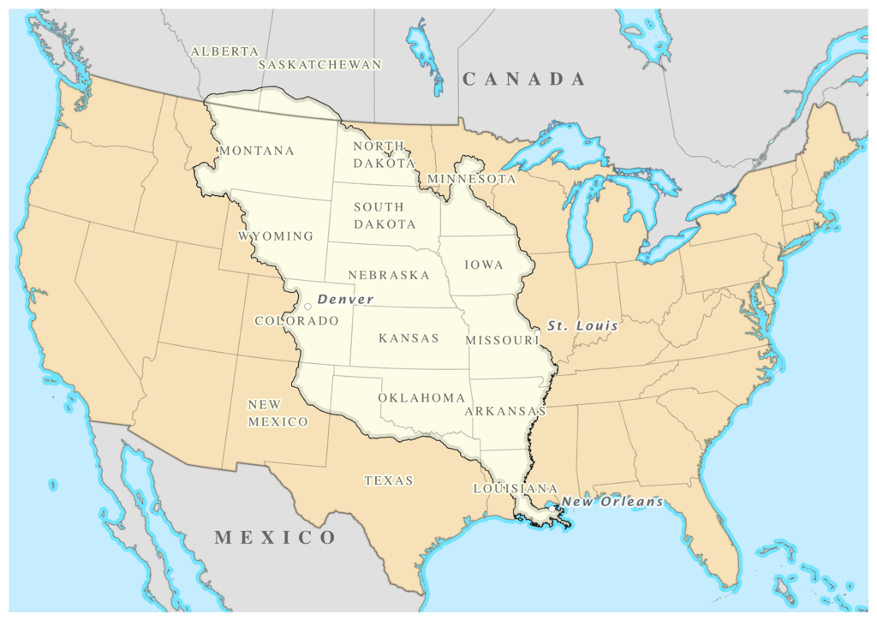
Background & History
Established in Louisiana by the Napoleonic Code
The Louisiana Purchase of 1803

Slide 4
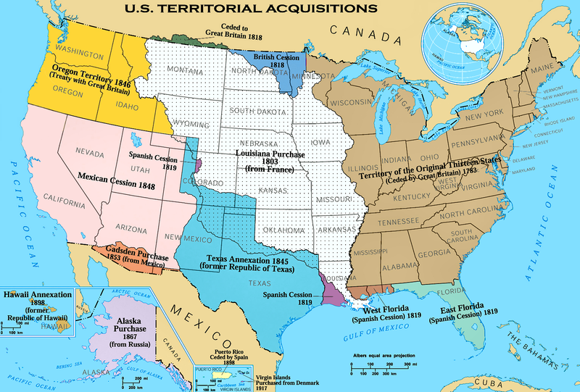
Background & History
Adopted in Texas, California and Southwest before colonial expansion
United States colonial Expansion across North America

Slide 5
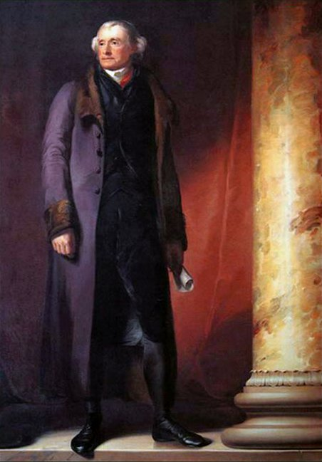
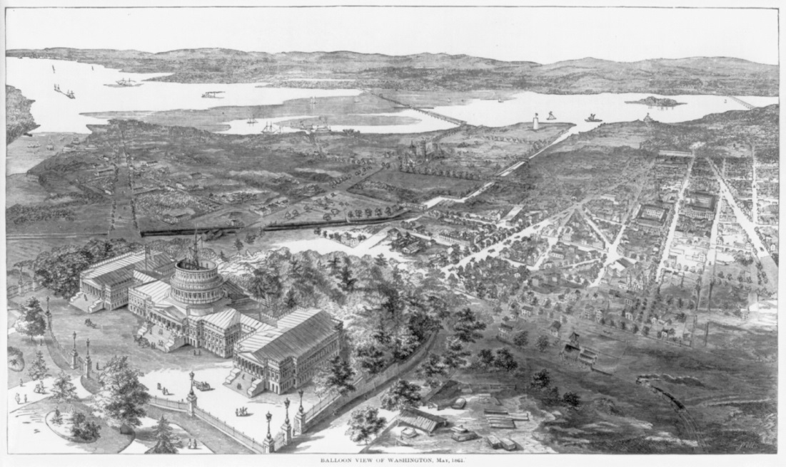
Background & History
Adopted by Thomas Jefferson to help draw construction workers to build Washington D.C. in 1781.

Slide 6
Mandated by State Laws
Every state in America establishes the rights of mechanic’s lien claimants in their constitution, statutes or codes.
CA, NC and TX in State Constitution
All other states in their state statutes in codes

Slide 7
Mandated by State Laws
Mechanic’s Lien Rights are created in two distinct lien forms:
Constitutional liens or Statutory liens

Slide 8
Constitutional Lien
Definition: A lien established in a given state’s constitution and agrees with that constitution. One significant advantage of constitution construction/mechanic’s liens is that they do not require claimant’s provision of notice to be a lien. Constitution liens are established by the following state constitutional provisions:

Slide 9
Constitutional Lien
Constitutional liens are established by the following state constitutional provisions:
California: Article XIV, Section 3
North Carolina: Article X, Section 3
Texas: Article XVI, Section 17

Slide 10
Statutory Liens
Definition: Statutory Lien - “A lien arising solely by force of statute upon specific circumstances or conditions, or lien of distress for rents, whether or not statutory, but does not include security interest or judicial lien, whether or not such interest or lien is provided by or is dependent upon statute and whether or not such interest or lien is made fully effective by statute.”
Bankruptcy Act - 11 U.S.C. 101(53)

Slide 11
Caution!
All states have similar, but unique Construction/Mechanic’s lien laws, so before you close, make sure you understand the pertinent state Construction/Mechanic’s lien laws applicable to the subject property and your deal.

Slide 12
Rights of Laborers
The rights afforded to construction laborers, also known as contractors and subcontractors, will be different if the laborer directly contracts with the owner of the property or sub-contracts with the primary or “general” contractor.
For title insurance purposes, identifying if a mechanic’s lien claimant is a direct contractor or a sub-contractor is often an important distinction.

Slide 13
Directly Contracted Contractors
Direct contractors are commonly referred to a “General Contractors” and will employ indirect contractors on a construction project.
Preferences under the law, as well as greater responsibilities, are often given to those laborers that have a direct contract with the owner of the land.
Direct contractors often have extended notice and lien filing periods.

Slide 14
In-Directly Contractors
Indirect Contractors are often referred to as “subcontractors”
Indirect contractors are hired by the direct or “general” contractor.
Subcontractors often are subject to shorter notice and lien filing periods.

Slide 15
Significance of Recording Laws
In many jurisdictions, a Public Records search cannot be relied upon to determine the existence of a Mechanic’s lien risk.
The rights of lien claimants are not necessarily fixed by the date and time of the recorded Mechanic’s lien or Notice of Lien. The priority of the claimant’s lien is often fixed by the date and time the work of improvement is commenced. Fortunately, these statements are not true in numerous states.

Slide 16
Commencement of Improvement
Established in some jurisdictions pursuant to a written and filed Notice of Commencement.
In other jurisdictions, it is established at the point a work of improvement is physically evident on the property.
Begins when construction equipment, materials or accessories (portable toilet, temporary power pole, construction trailer, soil testing, etc.) are evident on the property.

Slide 17
Record Notice of Commencement
In the States of Florida, Georgia, Michigan, Ohio, South Carolina, South Dakota, North Carolina and Texas, a recorded Notice of Commence is required.
A Notice of Commencement establishes in the Public Record when the work of improvement actually began.
This Notice eliminates the confusion associated with trying to determine when the work actually began.

Slide 18
Other Record Notices
Even in states that don’t have mandatory recorded Notices of Commencement, there are many recorded instruments that provide notice of possible Mechanic’s Lien claims.
Examples (although not a complete list)
Construction Deeds of Trust
Notices of Non-responsibility
Mechanic’s Liens
Release of Lien Bond
Notices of Action to foreclose a Mechanic’s Lien

Slide 19
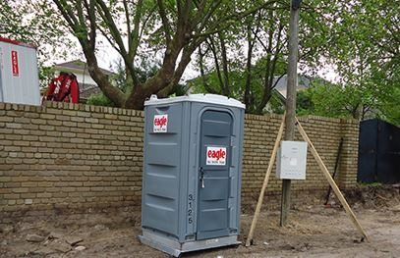
No Record Notice of Commencement
The rights of lien claimants may begin when the work of improvement becomes evident on the property.
The evidence could include the placement of a portable toilet, a temporary power pole, a construction trailer/modular office, weed abatement or soil compaction testing.

Slide 20
Submission of Direct Notice
In most jurisdictions across the country, before a lien claimant can file or record a Notice or Construction Lien or Mechanic’s Lien, he must present the owner of the property, the construction lender and the General Contractor (if appropriate) with written notice of payment is due.
This is often called a “20-day Notice”.
Title Insurers won’t get knowledge of this notice, but failure to provide it may void a lien claim.

Slide 21
Title Insurance Significance
Mechanic’s Liens have a significant effect on title insurance because they may establish lien rights prior to the insured’s interest.
Mechanic’s liens, if left unpaid, could be foreclosed, resulting in the complete elimination of the insured interest.
Disclosure of recorded Mechanic’s or Construction liens in a chain of title discloses an extra-hazardous risk and requires Underwriting Department review.

Slide 22
Title Policy Coverages
Mechanic’s/Construction Lien rights are covered under all title insurance policies that provide off-record coverages.
Owner’s Policy: Covered Risk 2(subject to Exclusion 3(a) and (b)
Loan Policy: Covered Risk 2, 10 and 11 (subject to Exclusion 3(a) and (b)
Post closing endorsements may also provide Mechanic’s lien coverage

Slide 23
Title Insurance Considerations
As been previously stated, insuring in the face of a possible mechanic’s lien claim is an extra-hazardous risk and must be elevated to an Underwriter for approval, no matter what the liability.
A Mechanic’s lien claimant’s rights may be present from before he contributes to the work of improvement and lasts as long as two years after all construction has been completed.

Slide 24
Title Insurance Considerations
Although the existence of Construction or Mechanic’s Lien rights present significant challenges to title insurers, several methods have been establish to provide both owner’s and lender’s insurance, mitigating the potential risk.
Providing the Underwriting Department with early warning of a potential construction situation will allow them to tailor an appropriate solution for your given set of circumstances.

Slide 25
Underwriting Risk
Because of the basic nature of this presentation, no discussion has been included about the processes, procedures or solutions available to the Underwriter in providing approval to close a transaction that involves a Construction lien risk. There are many options available and each involve thorough investigation and review, including the significantly complicated use of Credit Underwriting.

Slide 26
M/L Reference Matrix
Together with this presentation, a State-by-State Mechanic’s Lien matrix has been provided. This matrix includes the answers to the following issues:
The State authority for Mechanic’s lien rights
A Mechanic’s liens priority
The Mechanic’s lien filing period
The time allowed to file an enforcement action Click HERE to download the M/L Reference Matrix

Slide 27
Have Questions? Send Randy an email at: rwilliams@wfgnationaltitle.com

